Slide 1
Tuples

Slide 2
Problem
A hospital has received a set of lab reports. Totally five tests are conducted in the lab and the report is prepared. The report consist of name of the test and the value observed for that particular patient. Given the details of a test made for a patient, write an algorithm and the subsequent Python program to print if the test result is normal or not normal by referring the values in Table 1. Since the value is sensitive, provide a mechanism so that the values do not get altered.

Slide 3
Name of the Test | Minimum Value | Maximum Value
Test1 | 20 | 30
Test2 | 35.5 | 40
Test3 | 12 | 15
Test4 | 120 | 150
Test5 | 80 | 120

Slide 4
PAC For Lab Test Problem
Input | Processing | Output
Test name and a pair of values indicating the minimum and the maximum value for the five tests Name of the test and the value observed | Check if the observed value is in the range of permissible values for the test and print ‘Normal’ or ‘Abnormal’ | Print ‘Normal’ or ‘Abnormal’

Slide 5
Pseudocode LabTest Problem
FOR i =0 to 5
READ test_Name_{i}
READ minimum_{i}
READ maximum_{i}
Map test_Name_{i} to minimum_{i} and maximum_{i}
READ test_Name_Chk
READ observed_Value
END_FOR

Slide 6
IF observed_Value>min of test_Name_Chk
and observed_Value <max of test_Name_Chk
THEN
PRINT ‘Normal’
ELSE
PRINT ‘Abnormal’
END IF
Store the values such that it is not getting modified

Slide 7
We Already Know
To read values
Map a value to another - Dictionary
Print Values
Form a pair of values – List – But the values can be changed
Yet to learn about pairing values that cannot be modified

Slide 8
Tuples
Sequence of immutable Python objects
Tuples cannot be changed like lists and tuples use parentheses, whereas lists use square brackets.
Creating a tuple is as simple as putting different comma-separated values.
Optionally you can put these comma-separated values between parentheses also.

Slide 9
For example −
tup1 = ('physics', 'chemistry', 1997, 2000);
tup2 = (1, 2, 3, 4, 5 );
tup3 = "a", "b", "c", "d";

Slide 10
empty tuple −
tup1 = ();
To write a tuple containing a single value you have to include a comma −
a = (50) # an integer
tup1 = (50,); # tuple containing an integer
tuple indices start at 0

Slide 11
print ("tup1[0]: ", tup1[0]) # print physics
print ("tup2[1:5]: ", tup2[1:5]) # print (2,3,4,5)

Slide 12
Tuples in Action
>>> (1, 2) + (3, 4) # Concatenation
(1, 2, 3, 4)
>>> (1, 2) * 4 # Repetition
(1, 2, 1, 2, 1, 2, 1, 2)
>>> T = (1, 2, 3, 4) # Indexing, slicing
>>> T[0], T[1:3]
(1, (2, 3))

Slide 13
Sorted method in Tuples
>>> tmp = ['aa', 'bb', 'cc', 'dd']
>>> T = tuple(tmp) # Make a tuple from the list's items
>>> T
('aa', 'bb', 'cc', 'dd')
>>> sorted(T)
['aa', 'bb', 'cc', 'dd‘]

Slide 14
List comprehensions can also be used with tuples.
The following, for example, makes a list from a tuple, adding 20 to each item along the way:
>>> T = (1, 2, 3, 4, 5)
>>> L = [x + 20 for x in T]

Slide 15
Equivalent to:
>>>L = []
>>>for x in T:
L.append(x+20)
>>> L
[21, 22, 23, 24, 25]

Slide 16
Index method can be used to find the position of particular value in the tuple.
>>> T = (1, 2, 3, 2, 4, 2)
>>> T.index(2) # Offset of first appearance of 2
1
>>> T.index(2, 2) # Offset of appearance after offset 2
3
>>> T.count(2) # How many 2s are there?
3

Slide 17
Nested Tuples
>>> T = (1, [2, 3], 4)
>>> T[1] = 'spam' # fails: can't change tuple itself TypeError: object doesn't support item assignment

Slide 18
>>> T[1][0] = 'spam'
# Works: can change mutables inside
>>> T
(1, ['spam', 3], 4)

Slide 19
>>> bob = ('Bob', 40.5, ['dev', 'mgr'])
# Tuple record
>>> bob
('Bob', 40.5, ['dev', 'mgr'])
>>> bob[0], bob[2] # Access by position
('Bob', ['dev', 'mgr'])

Slide 20
# Prepares a Dictionary record from tuple
>>> bob = dict(name='Bob', age=40.5, jobs=['dev', 'mgr'])
>>> bob
{'jobs': ['dev', 'mgr'], 'name': 'Bob', 'age': 40.5}
>>> bob['name'], bob['jobs'] # Access by key
('Bob', ['dev', 'mgr'])

Slide 21
Dictionary to Tuple
We can convert parts of dictionary to a tuple if needed:
>>> tuple(bob.values()) # Values to tuple (['dev', 'mgr'], 'Bob', 40.5)
>>> list(bob.items()) # Items to list of tuples [('jobs', ['dev', 'mgr']), ('name', 'Bob'), ('age', 40.5)]

Slide 22
Using Tuples
Immutable which means you cannot update or change the values of tuple elements
tup1 = (12, 34.56);
tup2 = ('abc', 'xyz');
# Following action is not valid for tuples
tup1[0] = 100;

Slide 23
You are able to take portions of existing tuples to create new tuples as the following example demonstrates
tup3 = tup1 + tup2;
print (tup3)

Slide 24
Delete Tuple Elements
Removing individual tuple elements is not possible
But possible to remove an entire tuple
tup = ('physics', 'chemistry', 1997, 2000);
print (tup)
del tup;
print ("After deleting tup : ")
print (tup)
Error

Slide 25
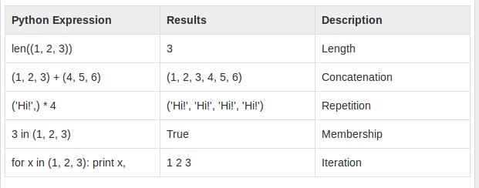
Basic Tuples Operations

Slide 26
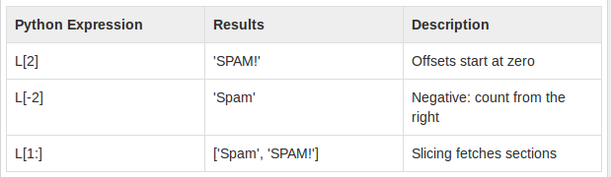
Indexing, Slicing
If L = ('spam', 'Spam', 'SPAM!')

Slide 27
Built-in Tuple Functions
tuple1, tuple2 = (123, 'xyz'), (456, 'abc')
len(tuple1)
2
When we have numerical tuple:
t1 = (1,2,3,7,4)
max(t1) #prints 7
min(t1) #prints 7

Slide 28
Converts a list into a tuple
tuple(seq)
t2=tuple([2,4])
>>> t2
(2, 4)

Slide 29
